Slide 1
ESSA / MKES / and Online Tools Discussion
Phyllis R. Snipes
School Library Media Program
University of West Georgia

Slide 2
Every Student Succeeds Act (ESSA)
…authorizes – but does not require - school districts to include in their plans how they will develop effective school library programs to provide students an opportunity to improve digital literacy skills and improve academic achievement. ESSA does not define an effective school library program; additionally, it does not require or mandate school librarian staffing, whether certified or not.
ESSA authorizes but does not require states, as well as districts to use grants and subgrants for:
Supporting the instructional services provided by effective school library programs.
Providing time for teachers and school librarians to meet, plan and collaborate on comprehensive literacy instruction.
Providing professional development for school librarians
Providing access to school libraries
ESSA has placed school library media programs in an excellent position. We must now work to ensure that our presence is maintained.

Slide 3
Every Student Succeeds Act (ESSA)
http://www.ala.org/aasl/advocacy/legislation/essa
We have a unique opportunity !!! Speak out by September 26 !!!
essa@doe.k12.ga.us
State.superintendent@doe.k12.ga.us

Slide 4
Every Student Succeeds Act (ESSA)
Areas of impact:
Accountability
Assessment
Education of the Whole Child
Federal Programs
Teacher and Leader Development
http://www.glma-inc.org/

Slide 5
ESSA Listening Sessions
September 19: Muscogee County, Northside High School, 2002 American Way, Columbus, GA 31909
SATURDAY, September 24: GLMA / AASL ESSA meeting, Teaching Museum South, 689 N. Ave., Hapeville
October 6: Dougherty County, Dougherty Comprehensive High School, 1800 Pearce Ave, Albany, GA 31705
October 12: Laurens County, Old West Laurens (OWL) Training Center, 338 West Laurens School Road, Dublin, GA 31021
October 13: Chatham County, Pulaski Elementary School, 1001 Tibet Avenue, Savannah, GA 31419
October 17: Gordon County, Gordon County College & Career Academy, 305 Beamer Road, Calhoun, GA 30701

Slide 6
[MKES]
Name change forthcoming (something such as “School Librarian Effectiveness Instrument”)
Standards have had some changes in wording; examples:
Professional Development now defines “published works” as including digital/social media formats that reach beyond the school (Level IV)
Future-ready librarian language now included
http://knowledgequest.aasl.org/future-ready-librarian
http://www.techlearning.com/future-ready-schools/0022/future-ready-schools/69752
http://slmadvocacy.weebly.com

Slide 7
Best Websites for Teaching and Learning - AASL
http://www.ala.org/aasl/standards/best/websites

Slide 8
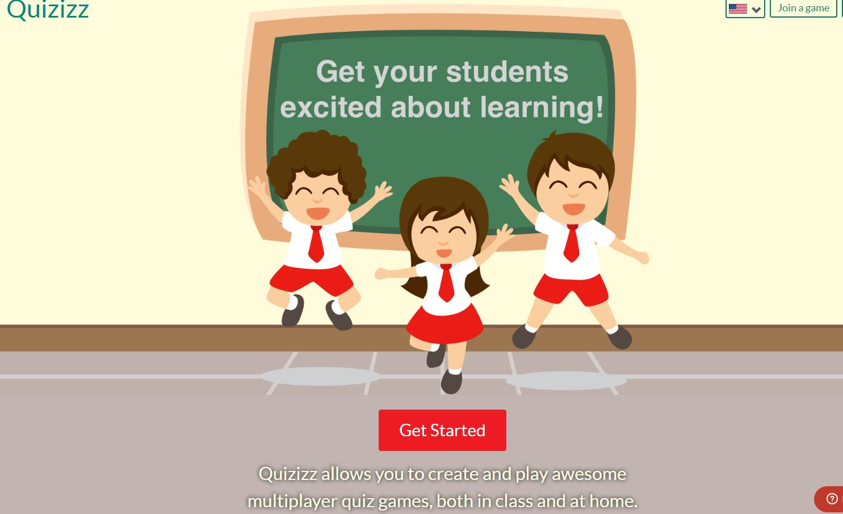
Social Networking

Slide 9
TEST TIME !!!
http://quizizz.com
join.quizizz.com

Slide 10
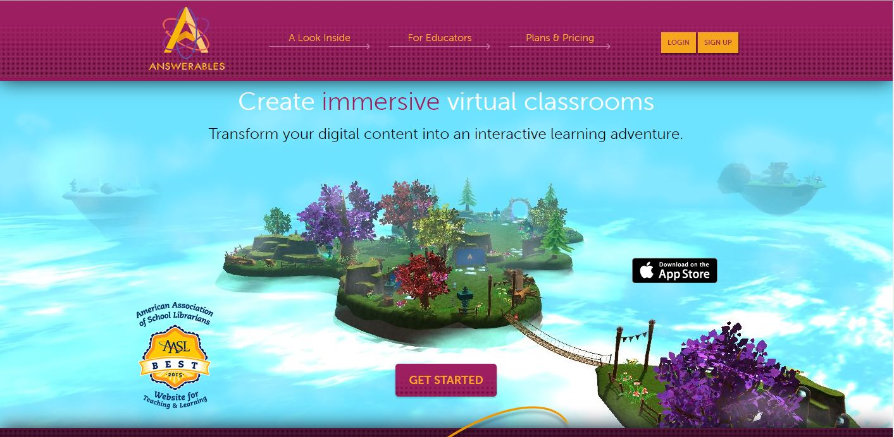
Social Networking

Slide 12
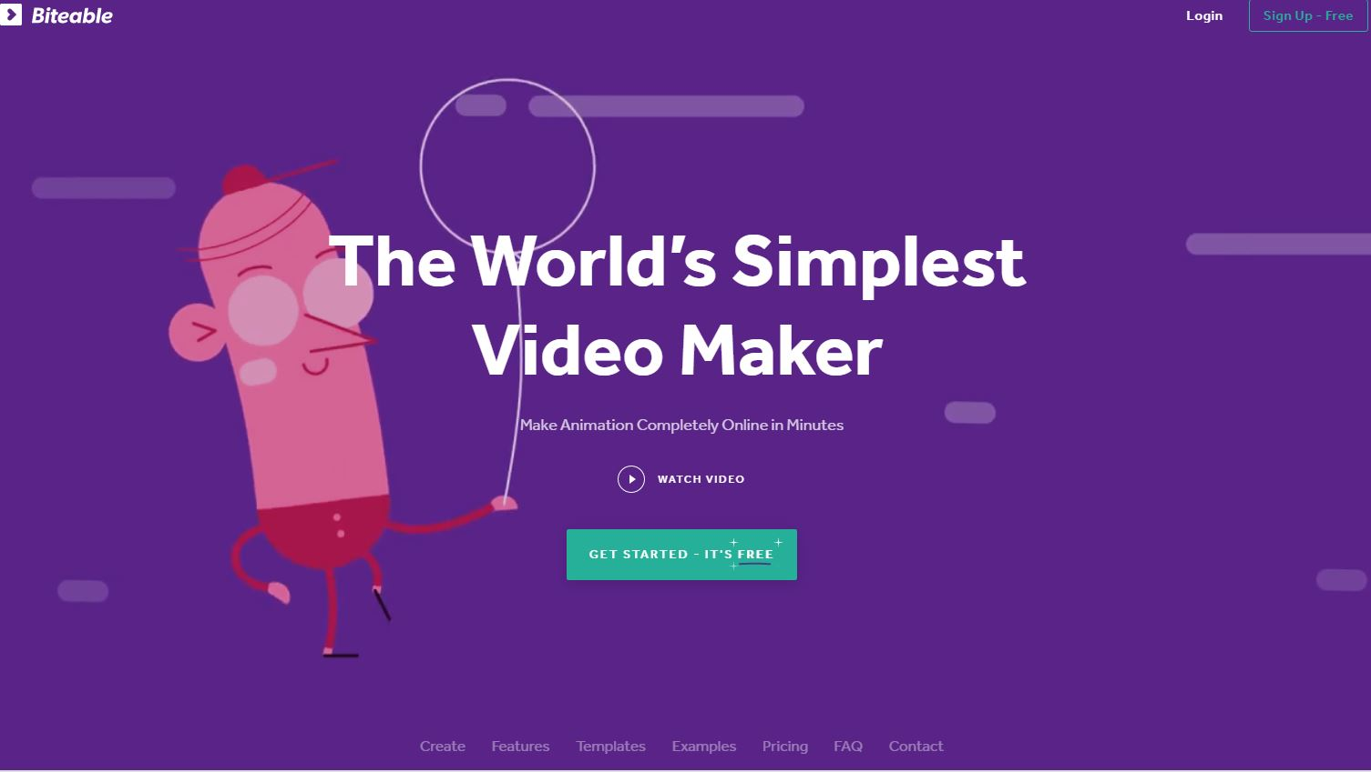
Digital Storytelling

Slide 13
Biteable
https://biteable.com

Slide 14
Curriculum Collaboration

Slide 16
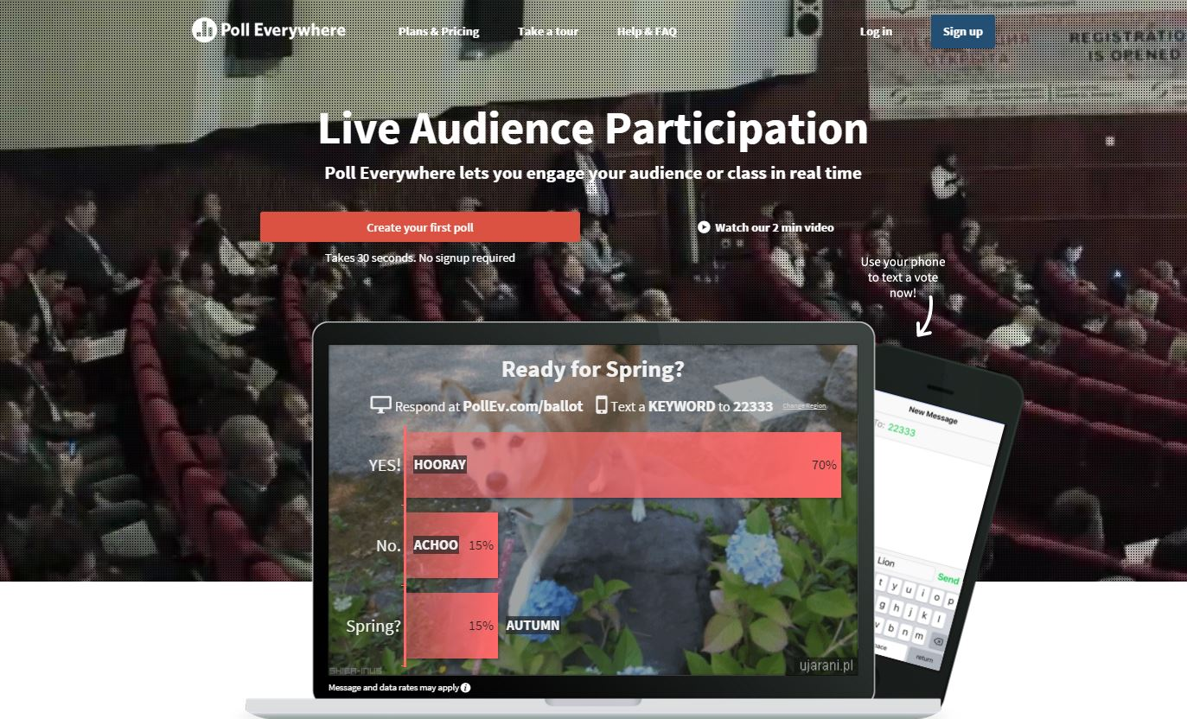
Content Collaboration

Slide 17
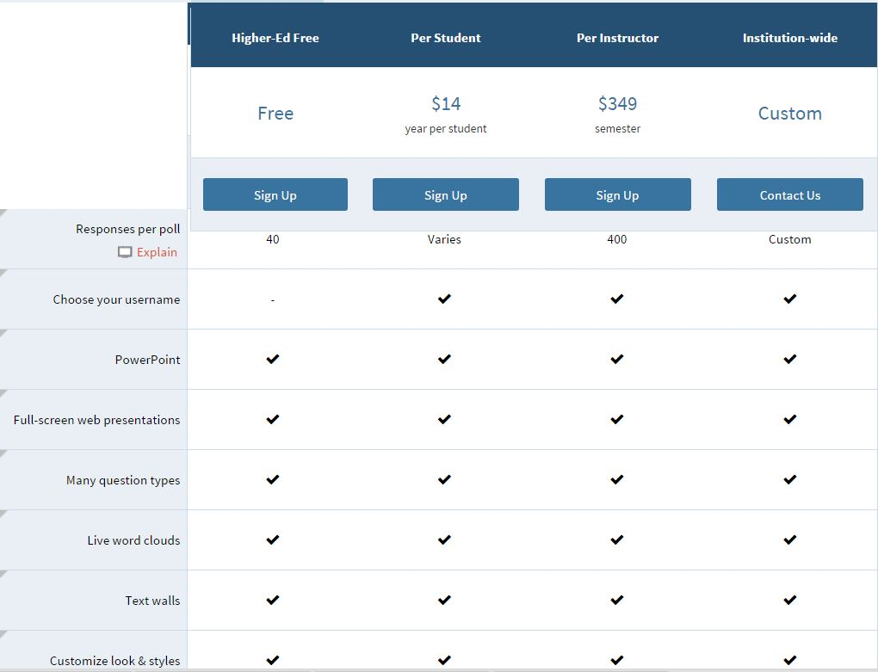

Slide 18
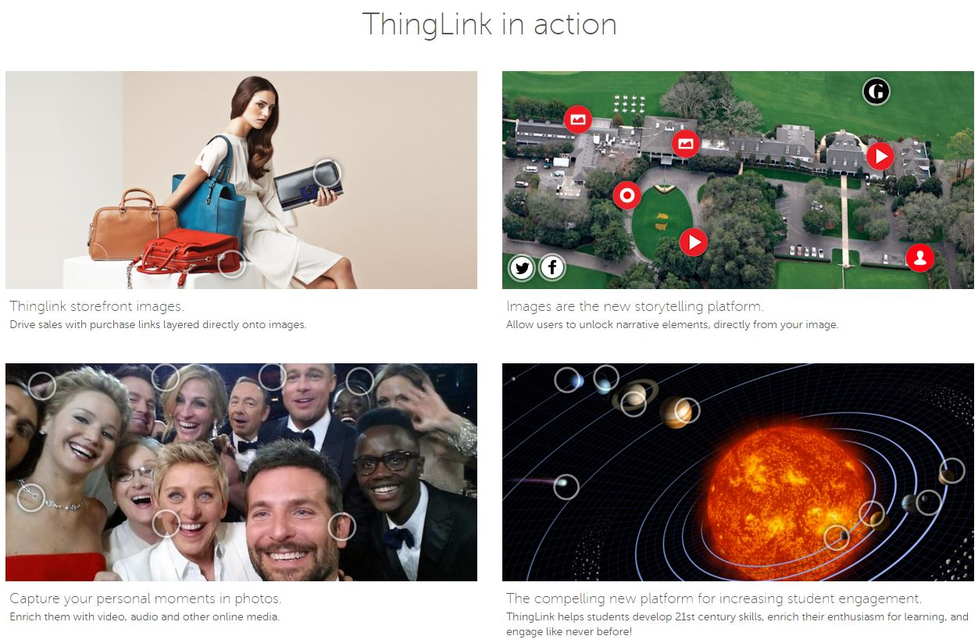
Media Sharing

Slide 19
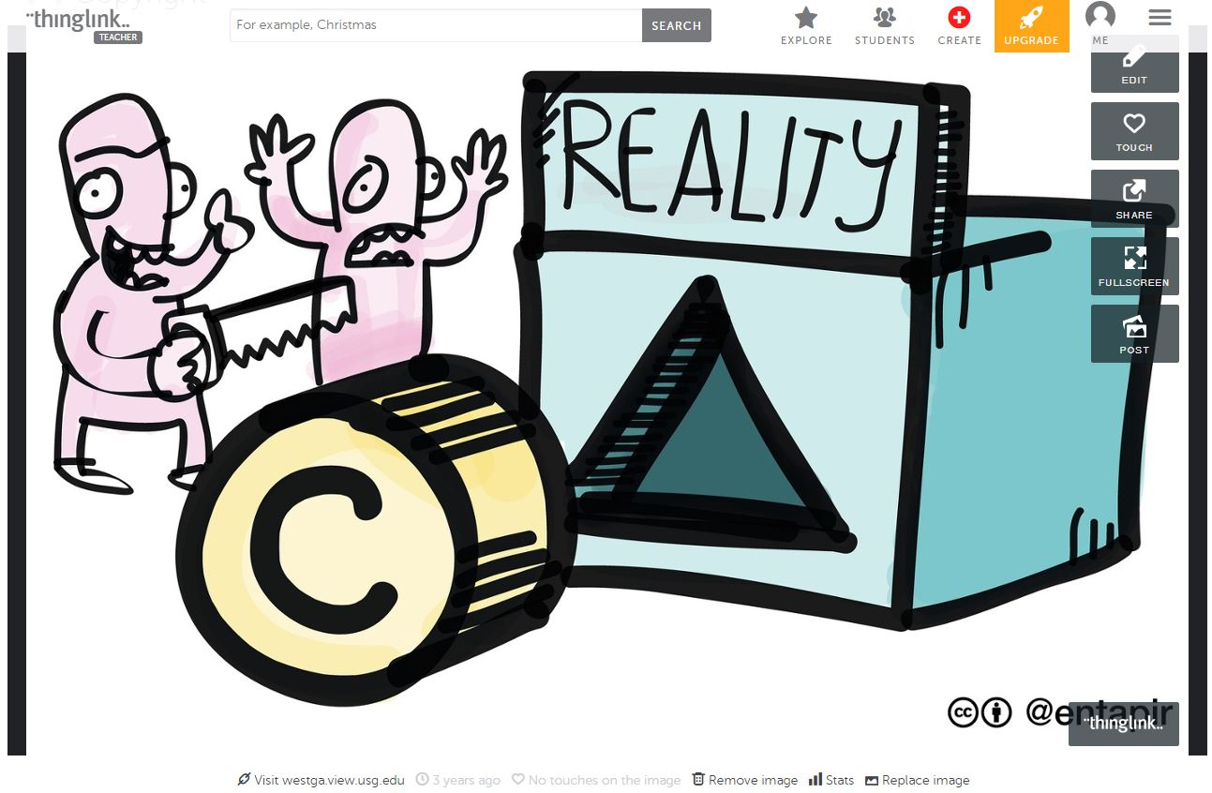

Slide 20
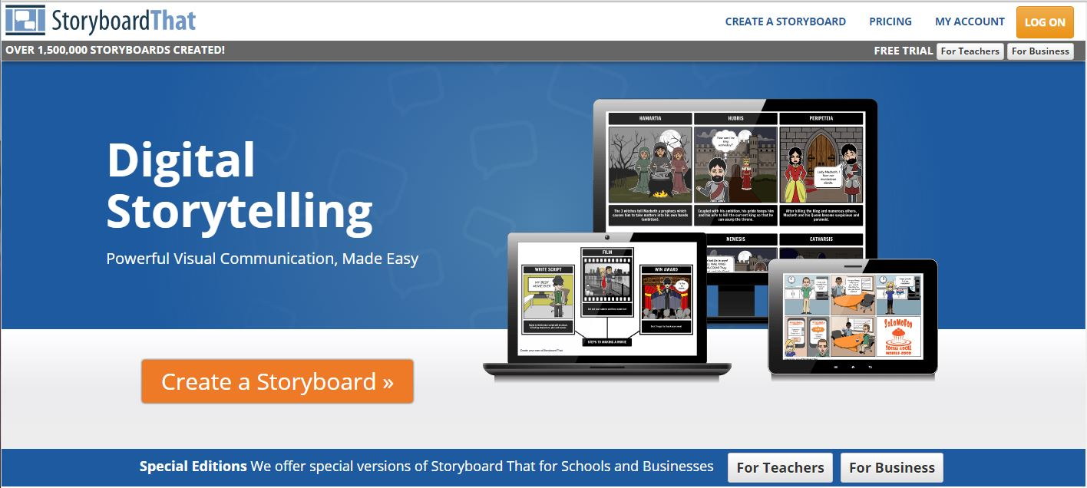
Media Sharing

Slide 21
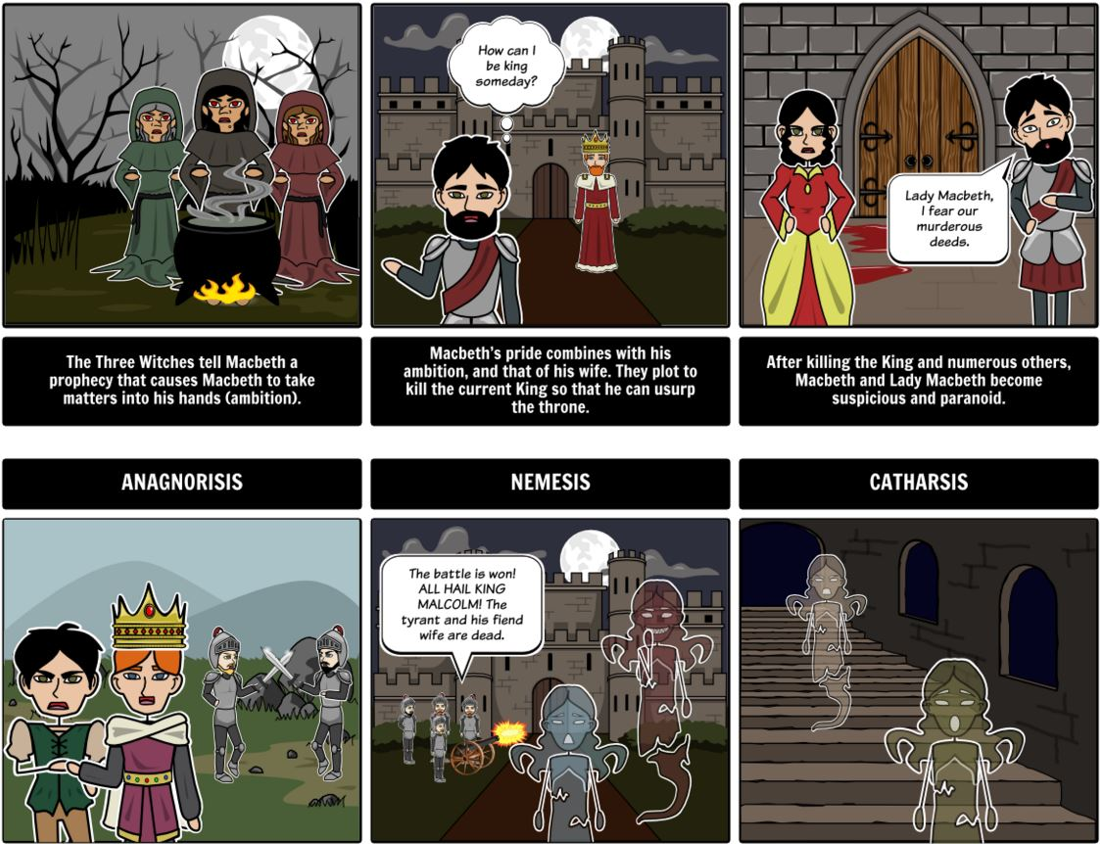

Slide 22
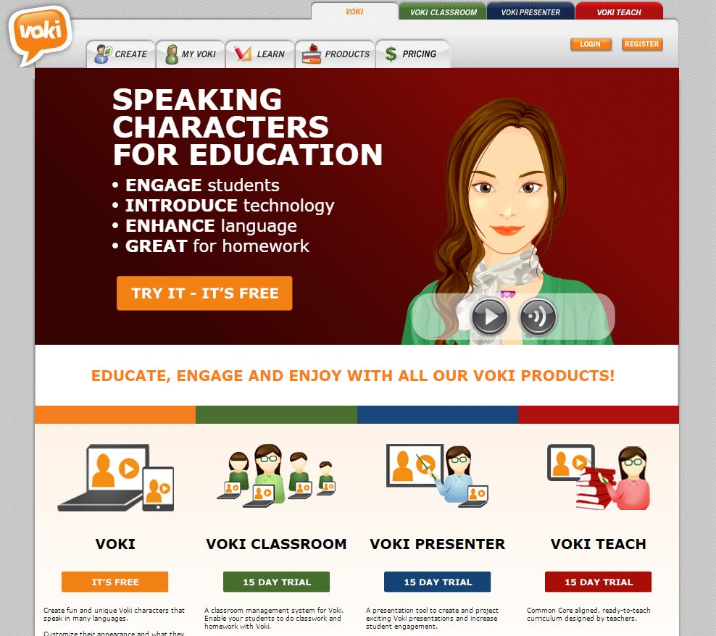
Media Sharing

Slide 23
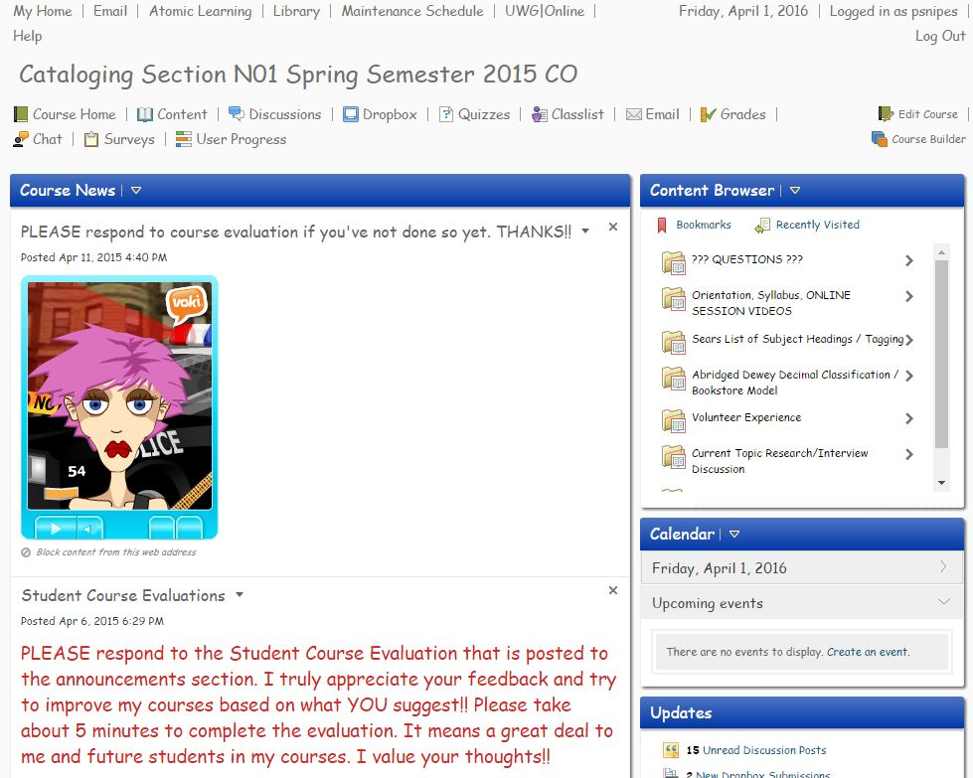

Slide 24
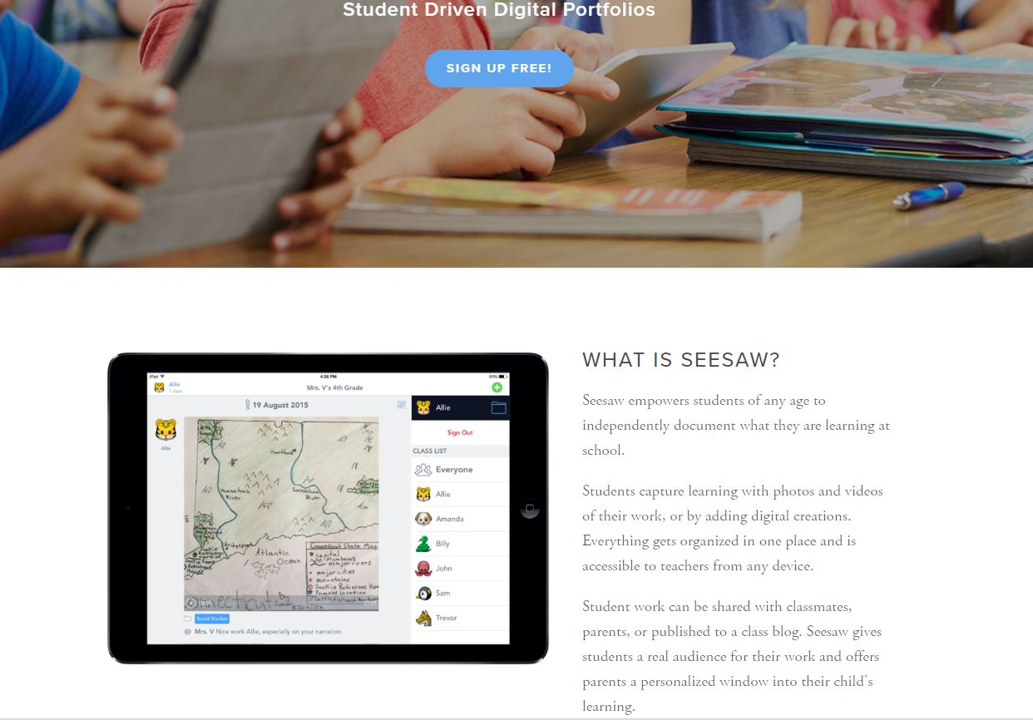
Manage / Organize

Slide 25
Seesaw
http://web.seesaw.me/

Slide 26
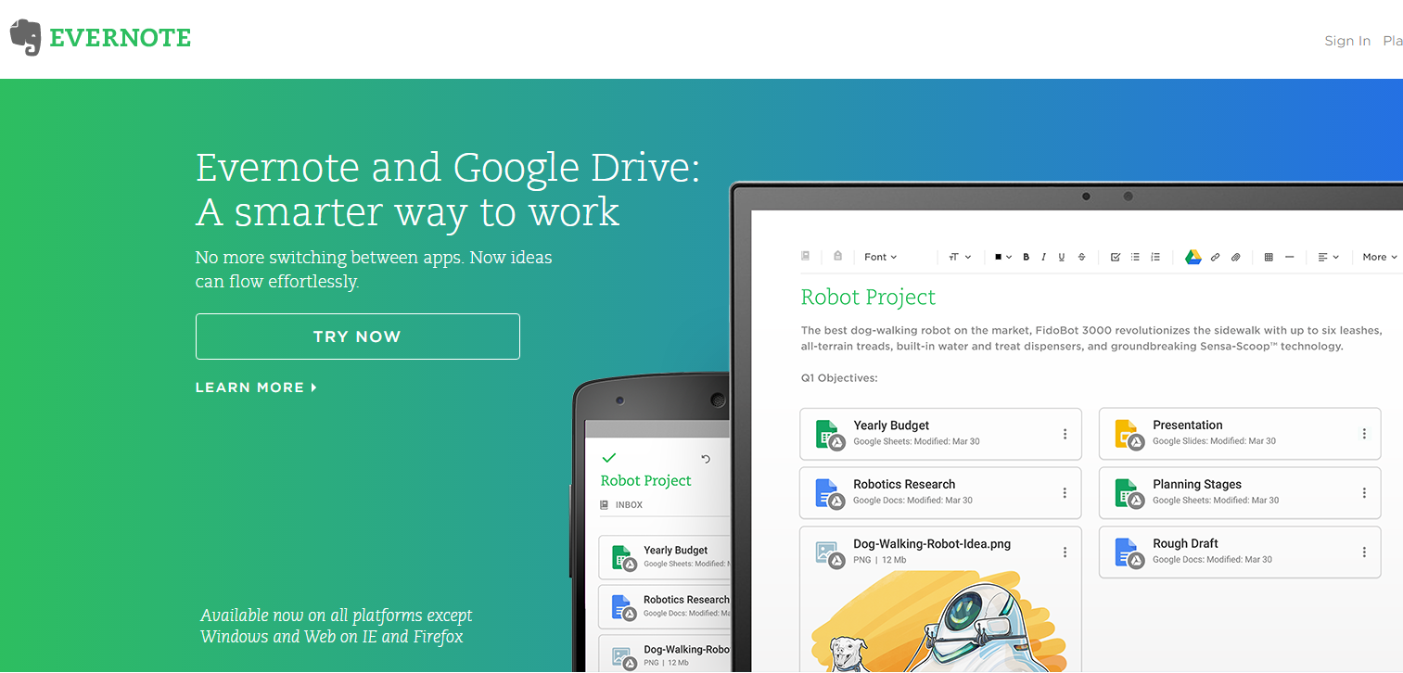
Manage / Organize

Slide 27
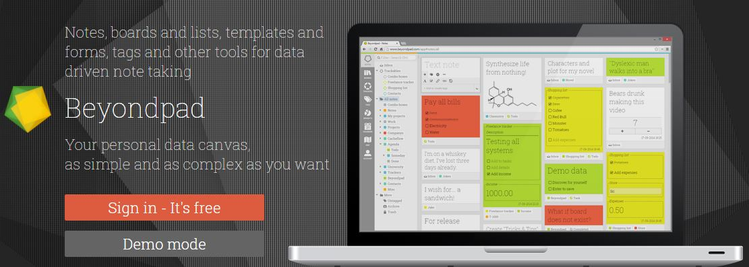
Manage / Organize

Slide 28
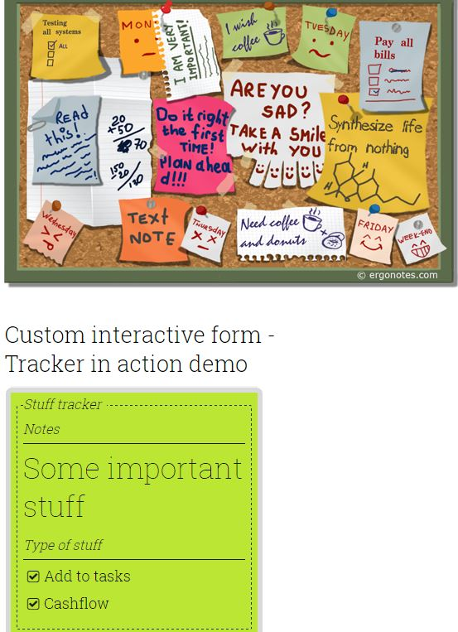

Slide 29
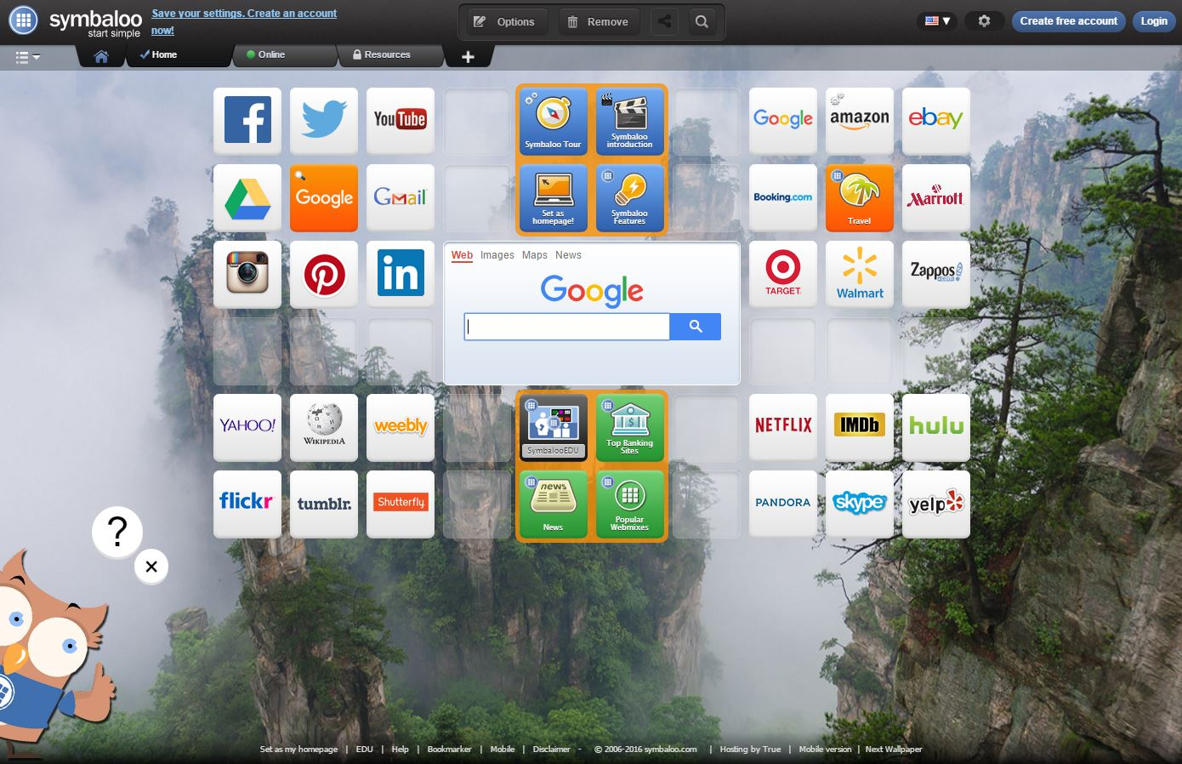
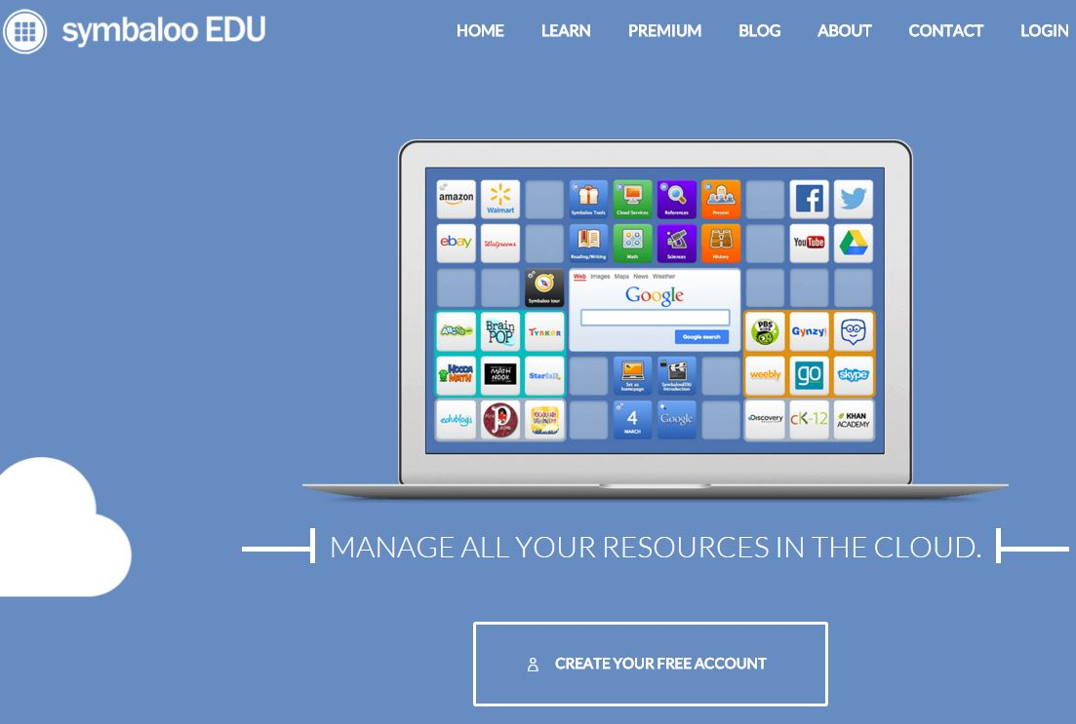
Keep up with all
of your websites!
Symbaloo

